Slide 1
Introduction to Study documents

Slide 2
Study documents
Protocol
Case Report Forms (CRFs)
CRF Completion Guideline
Annotated CRFs
Statistical Analysis Plan
Specifications
Mock Shells

Slide 3
Protocol
The study protocol is the blueprint that all researchers follow.
A study protocol is a document that describes, in detail, the plan for conducting the clinical study. The study protocol explains the purpose and function of the study as well as how to carry it out.
Typically Protocol includes following:
The reason for the study
The number of participants
Eligibility and exclusion criteria
Details of the intervention or therapy the participants will receive (such as frequency and dosages),
What data will be gathered
What demographic information about the participants will be gathered
Steps for clinical caregivers to carry out
Study endpoints.

Slide 4
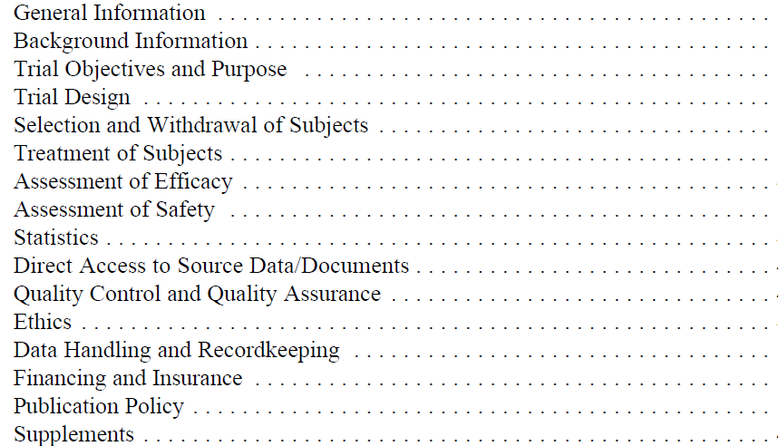
Contents of Protocol (as per ICH guidelines)

Slide 5
Case Report Forms
A case report form (CRF) is a data collection tool used in clinical trials to support investigators and coordinators in capturing all protocol-required information.
The International Conference on Harmonization Guidelines for Good Clinical Practice define the CRF as: A printed, optical or electronic document designed to record all of the protocol – required information to be reported to the sponsor on each trial subject.
A well-designed CRF should represent the essential contents of the study protocol and in an ideal situation, CRF is designed once the study protocol is finalized.
The data from the CRFs is compiled as a dataset into a database and validated prior to statistical analysis.
Paper CRF is the traditional way of data capture and a better option if studies are small or vary in design, whereas eCRFs are considered if studies are large with similar designs.
eCRFs are preferred over paper CRFs as they are less time-consuming, and also encourage the sponsor/pharmaceutical company to carry out large multicentric studies at the same time due to the ease of administration.

Slide 6
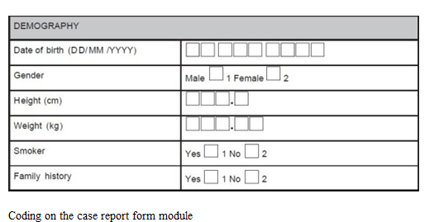
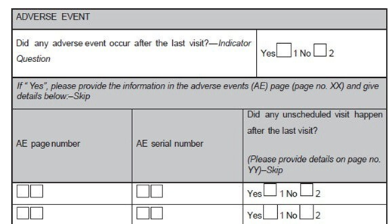
Examples of CRF

Slide 7
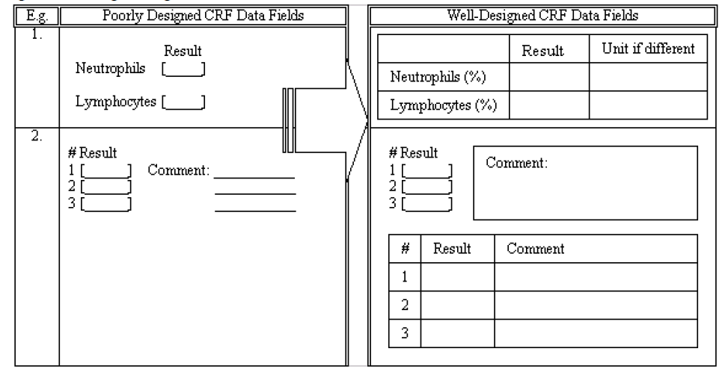
Poorly designed v/s Well-designed CRFs

Slide 8
CRF completion Guideline
The guidelines help to bridge the gap between the study protocol and the users in regards to CRF completion, correction, signing and handling procedures.
Data formats for appropriate response fields, a data correction guide, how to handle unknown or unavailable data, and a retrieval schedule for completed CRFs can be outlined.
instruct how to handle missing or unavailable data. If a required piece of information or entire section cannot be retrieved, the use of “NA”, “ND” or “UNK” can be defined to avoid ambiguous responses.
The guidelines can also demonstrate how to complete CRF pages for unscheduled assessments or in the cumulative log.
Furthermore, CRF retrieval procedures including how to handle CRFs for subjects who have discontinued during the study can be listed.

Slide 9
Annotated CRFs
What This is a blank CRF annotations that document the location of the data with the corresponding names of the datasets and the names of those variables included in the submitted datasets
Annotations are meant to help the FDA reviewer find the origin of data variables included in the submitted datasets
Annotations should reflect the data submitted within the SDTM

Slide 10
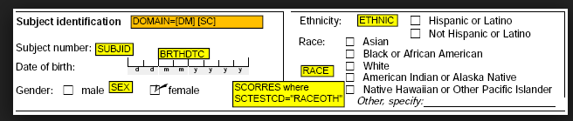
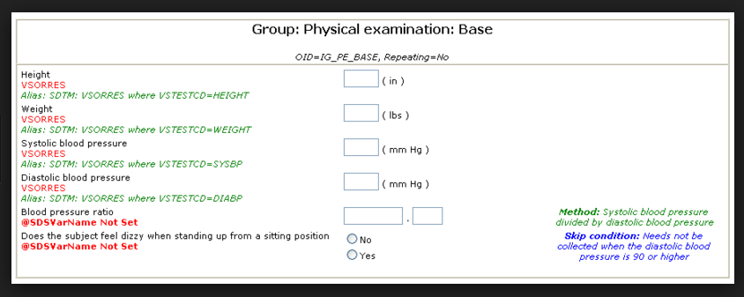
Examples of Annotated CRF

Slide 11
Statistical Analysis Plan
A statistical analysis plan (SAP) describes the planned analysis for a clinical trial.
Protocol outlines the analysis, SAP describes the statistical techniques for study analysis in detail.
The SAP defines all the statistical output which will be included in the clinical study report.
Shell tables, figures and sometimes listings are usually attached to the SAP although they should not be formally part of the SAP.
Usually the SAP is written by the trial or project statistician by using a template.
According to ICH E9 the statistical analysis is planned a priori.
Notes:
All statistical programming deliverables are defined in SAP

Slide 12
Statistical Analysis Plan (Contd…)
Clinical trial statistician needs to ensure that the SAP is carefully reviewed and approved prior to unblinding of the study.
For open label studies the SAP should be reviewed and approved prior to database lock approval.
The SAP is a document which is submitted to regulatory authorities as part of a submissions package.
The SAP is part of the appendix of a clinical study report.
The SAP is stored in the trial master file and it is used during audits to check if statistical programming followed exactly the descriptions in the SAP.
Besides the technical statistical details it should contain brief descriptions and summaries of the protocol, rather than just referring to the protocol.

Slide 13
Contents of SAP
Brief description of the study and purpose – e.g. description of conduct details which are important for analysis, study objectives and variables
Statistical methods to be used – e.g. summary statistics of subject data (means, standard deviations, extreme values, counts with corresponding percents), statistical tests (analysis of variance, t-tests, )
Description of analysis populations – e.g. safety set, per protocol set, full analysis set, Data handling rules – e.g. imputation rules, algorithms for derived variables
Complete table of contents with all TFLs to be produced by the statistical programmer as attachment to the SAP text (i.e. not as an appendix or any other formal and official part of the SAP)
Shell TFLs to be produced by the statistical programmer to define the layout of the TFLs as attachment to the SAP text (i.e. not as an appendix or any other formal and official part of the SAP)

Slide 14
Specifications
Specifications are data derivation rules for creating variables required in Source datasets/ Analysis Datasets
Specifications should provide details of attributes along with derivation rules for each variable in Source/Analysis dataset
If you follow CDSIC data standards then you need to follow SDTM and ADaM Guideline while writing data derivation rules

Slide 15
Table Shells
Shells are layout of how you want to present data in a Table, Listing or Figure
Shells should provide relevant Titles and Footnotes
If Possible provide programming notes to clarify the information presented in Shell.

